Slide 1
Immunobiology
Definition of the Immune System
The immune system is an organization of cells and molecules with specialized roles in defending the body against infection.
An immune response encompasses events involving both immunologic cells (phagocytes, lymphocytes) and soluble mediators (complement, cytokines, antibodies).
Role/Function
First: recognition of the pathogen or foreign matter – Self vs Non-Self
Second: a reaction to eliminate it
Characteristics
Specificity - to help distinguish against non-cross-reacting antigens
Memory – to allow a quicker and more vigorous response to pathogen invasion
Mobility – to allow local reactions the ability to provide systemic protection
Replicability – to allow the immune system to be amplified
Two Types of Immune Responses
1- Innate Response – 1st line of defense against pathogen & present from birth
- Phagocytic cells ( macrophage/monocyte, neutrophils)
- Inflammatory mediators (basophils, eosinophils, natural killer cells)
2- Adaptive Response – proliferation of antigen-specific T & B cells
- Humoral immunity (B cells)
- Cell-mediated immunity (T cells)
Graft Terminology: Autograft – Isograft – Allograft - Xeograft

Slide 2
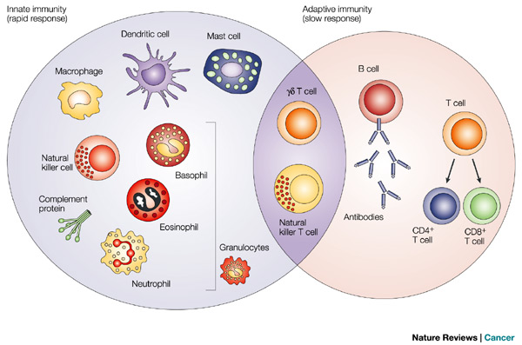
Antigen-presenting
Angioedema/anaphylaxis
HUMORAL IMMUNITY
Recognize bacteria/toxin
1st line of defense against pathogen
Highly specific for a particular pathogen
IgG, IgM, IgA, IgD, IgE
CELL-MEDIATED IMMUNITY
ONLY Recognize processed antigen
Surveillance against tumor/viral infected host cells
Against bacteria/fungus
REJECT TRANSPLANT
Parasitic/ allergic
http://people.eku.edu/ritchisong/301notes4b.html

Slide 3
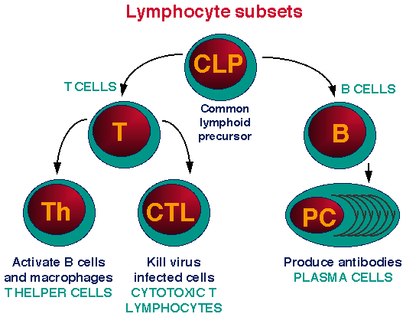

Slide 4
Categories of T Lymphocytes
T helper cells (CD4) - used to stimulate other cells in the immune response - Functionally divided into:
- TH₁ cells which secretes interleukin-2 (IL-2) and stimulates cytotoxic T cells.
- TH2 cells which secretes IL-4, 5, 10 and stimulates production of B cells and antibodies.
CD8+ suppressor cells - down-regulate the immune response once the pathogen is destroyed.
CD8+ cytotoxic cells - kills cells recognized as foreign. These are the cells mainly responsible for the rejection of the transplanted organs/ grafts.

Slide 5
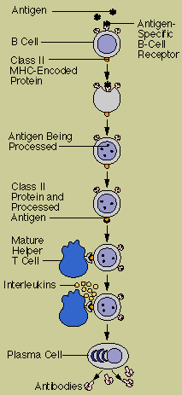
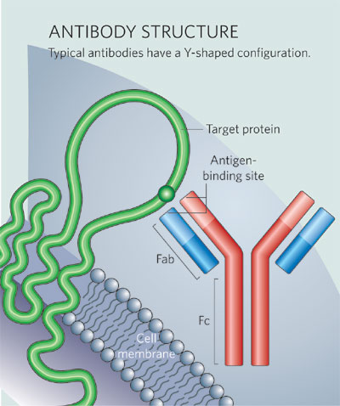
FAB: fragment antigen binding
FC: fragment crystallizable interacts with cell surface receptor

Slide 6
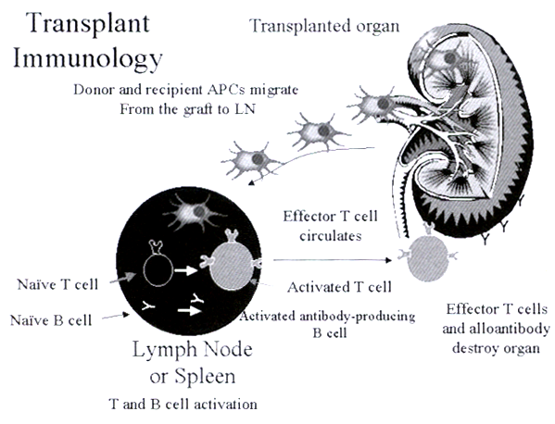
APC: antigen-presenting cells

Slide 7
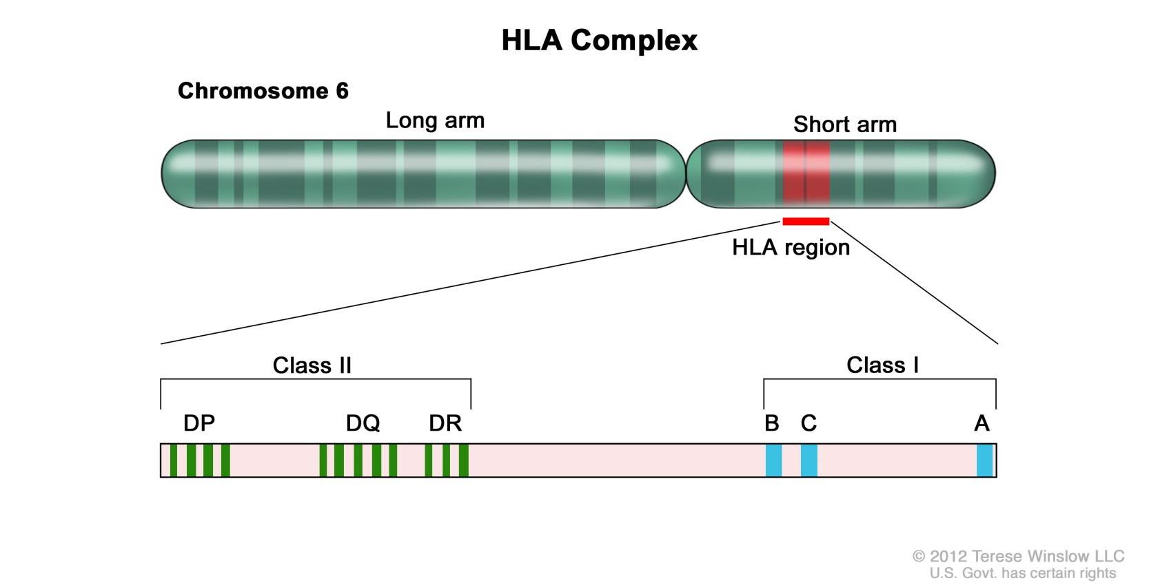
Transplantation Immunobiology
Major Histocompatibility Complex (MHC) – general term for vertebrates while HLA is for human
MHC is an association of genes found on the short arm of chromosome 6 also known as Human Leukocyte Antigen (HLA) System - since they are located on the surface of leukocytes in humans
A haplotype is a group of genes within an organism that was inherited together from a single parent - MHC haplotypes are inherited from both parents and are co-dominantly expressed
Rejection/ acceptance of a transplant is an inherited characteristic
Class III : 4 loci in class III gene region

Slide 8

MHC divided into 3 different classes
Class I Genes
There are 3 loci - HLA-A, HLA-B and HLA-C.
Class I genes are found on all nucleated cells in the body as well as platelets.
Class II Genes
The Class II genes known as “HLA-D genes.” - HLA-DP, HLA-DQ, HLA-DR
Class II genes are found primarily on B lymphocytes and macrophages/monocytes. They have a more restricted cell distribution compared to Class 1 genes.
The genes in Class I and II play a central role in the initiation of the immune response to transplantation antigens.
Class III Genes
There are four loci in the class III gene region.
These genes code for complement and tumor necrosis factor (TNF).

Slide 9
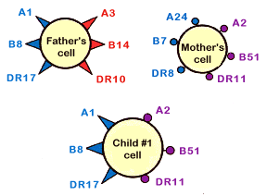
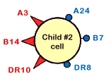
It is important to know that HLA is inherited as a "set" of the three HLA classes
Humans are called diploid organisms because they have two alleles at each genetic locus, with one allele inherited from each parent
It is very rare to get an exact match between 2 people, except for identical twins and some brothers & sisters
http://www.nature.com/scitable/definition/allele-48
https://www.ucdmc.ucdavis.edu/transplant/learnabout/learn_hla_type_match.html

Slide 10
The ABO System
The nomenclature of the ABO system is based on which antigen or antigens is present on an individual’s RBC
People also produce antibodies against the antigens they lack
Blood group | Antigen on RBC | Antibody in serum
A | A | β
B | B | α
AB | Both A and B | Neither α nor β
O | Neither A nor B | Both α and β
Type O: universal donor
Type AB:
universal recipient

Slide 11
Pathogenesis of the Immune Response
Compartmentalization of the immune response into components of alloantigen recognition, lymphocyte activation, clonal expansion and graft inflammation provides a framework for understanding the current clinical approach to donor-recipient matching and immunosuppressive therapy
Mechanism of the Rejection Process
Phase of the Immune Response | Immune System Requisites | Current Clinical Intervention
Alloantigen recognition | Presentation in context of MHC molecules | Antilymphocyte antibodies
Lymphocyte activation | Stimuli to transcribe IL-2 | Cyclosporine Tacrolimus Basiliximab Belatacept
Clonal expansion | IL-2 and IL-2R expression | Mycophenolate mofetil Mycophenolate sodium Azathioprine Sirolimus Everolimus
Graft inflammation | Adhesion molecules and chemokine expression | Steroids Antilymphocyte antibodies

Slide 12
Types of rejection episodes

Slide 13
Factors Affecting Allograft Outcome
Early, frequent acute rejection episodes
Often associated with poor long-term graft outcomes
Graft function
Delayed graft function, resulting in acute tubular necrosis in kidney transplant recipients is associated with poor long-term graft outcome
Previous sensitization
Pregnancy, blood transfusions and/ or previous transplants may sensitize patients and place them at high risk for rejection
The risk is defined by level of panel reactive antibodies (% PRA). This test measures a patient’s degree of sensitivity to antigens in the general population. Generally a PRA ≥ 25% is considered to proffer a greater risk for rejection.

